Slide 1
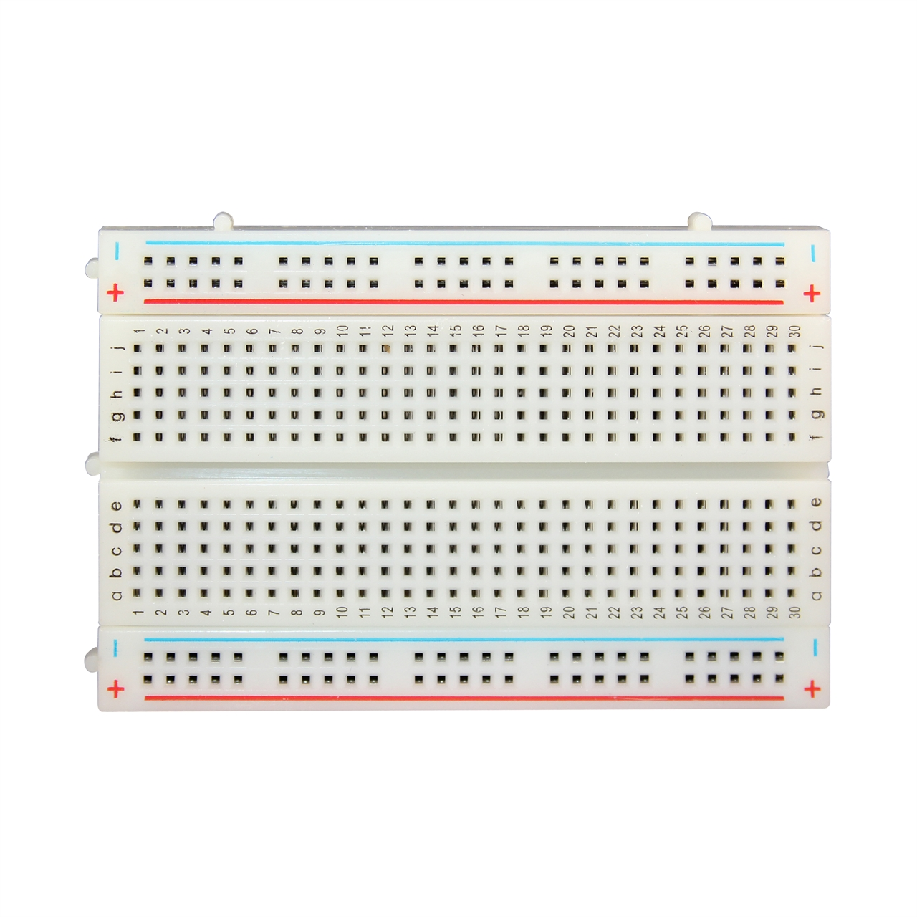
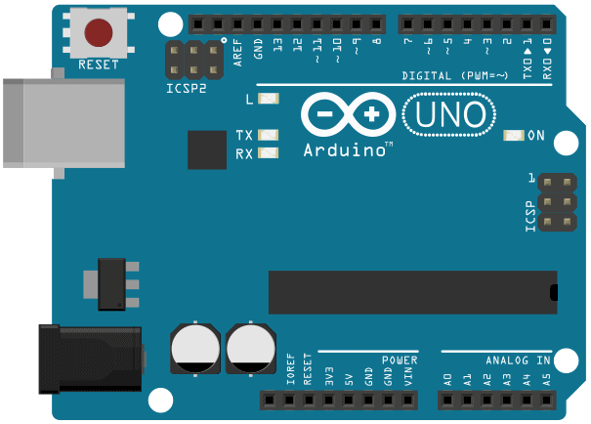
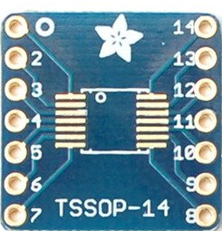
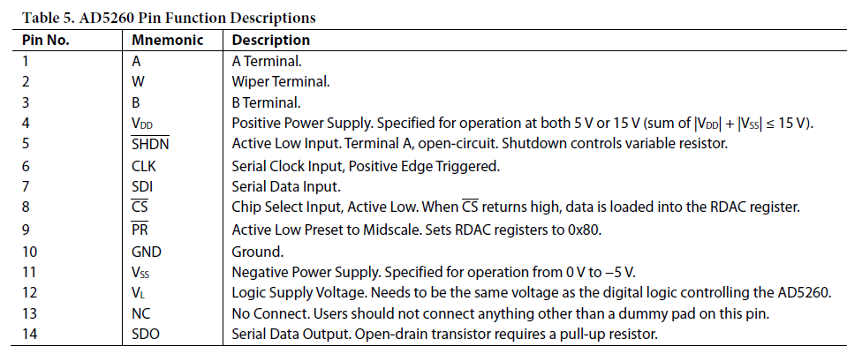
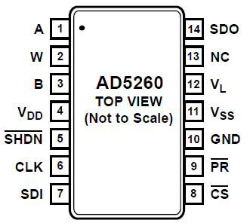
Trial of DigiPot Via Arduino UNO
Output (0-5V)
AD
5260

Slide 2
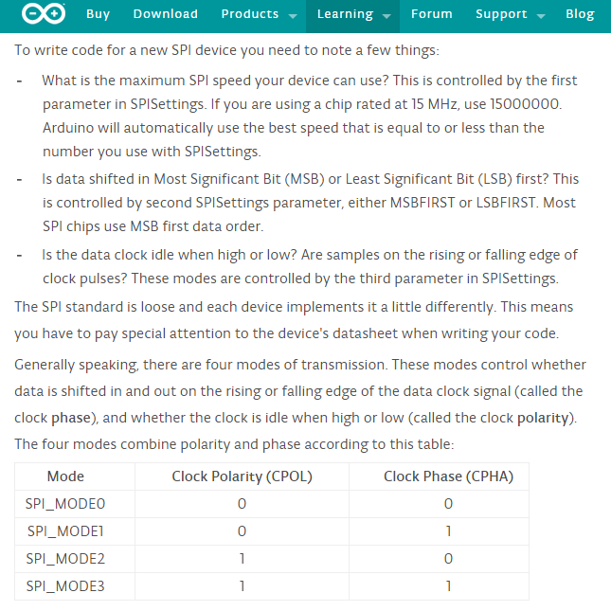
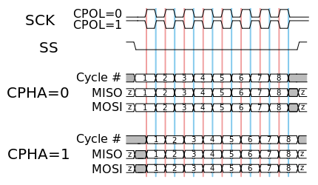
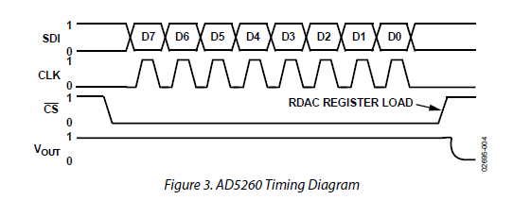
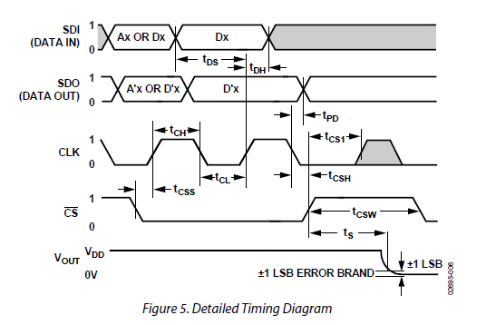
https://www.arduino.cc/en/Reference/SPI
https://en.wikipedia.org/wiki/Serial_Peripheral_Interface_Bus
AD5260:
SPI up to 20MHz (?)
MSB First
CLK Idle low. (CPOL=0?)
CLK is positive edge (CPHA=0?)
So SPI_MODE0

Slide 3
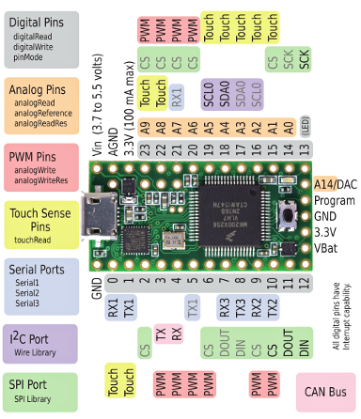
Trial of Digipot using Teensy 3.1
Output (0-5V)
AD
5260

Slide 4
Possible Hook-Up of Digipot to Polysix if Using Solderless Breadboard
Serial
3.3V
A,B,C
INH
Env In
Out
5.0V
AD
5260
Gnd

Slide 5
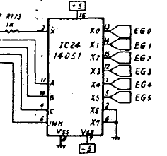
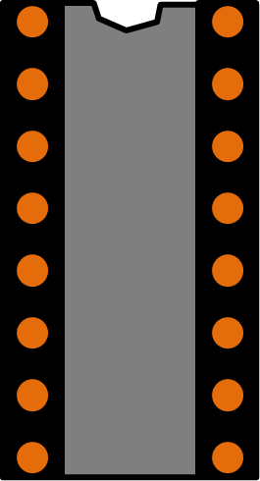
Configuration if wiring to Polysix IC24
Serial
5V
3.3V
To R113
AD
5260
16
2
15
3
14
4
13
IC24 14051
5
12
6
11
7
10
8
9

Slide 6
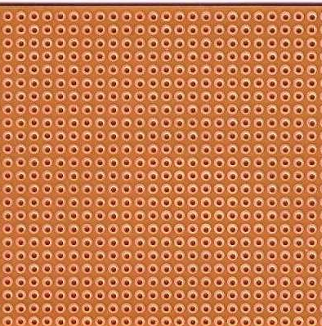
Configuration if on IC24, veroboard (This is the actual circuit as of Oct 11, 2015)
Serial
24 holes
16
15
14
13
12
11
10
9
IC24 14051
AD
5260
2
3
4
5
6
7
8
24 holes

